Slide 1

VOLTORB - AUGUST
PIR , Ultrasonic and Gas sensor

Slide 2
Problem statement
Peach Salinger, one of the Victoria's secret model met with an accident and now that she is physically handicapped it's difficult for her to use conventional wall switches located in different parts of the house. So she thinks of transforming her house from conventional wall switches to centralised control system. So it's upto you to make her house fully automated.
She specifies the following things:
1. The main door being single acting should open inwards for 10s whenever a person comes within 50cm from the door.
2. If there's any movement detected in the living area, the lightings should turn ON automatically and should stay in the same state for atleast 30s and should turn OFF when there's no movement detected.
3. If LPG gas leakage sensed inside the kitchen, the exhaust fan should turn ON automatically and also should create an alert inside the house.
Instructions:
Usage of microcontroller and different sensors is allowed.
1
2
4

Slide 3
Hints:
1
01
Use PIR sensor for detecting movement in the living area.
2
02
For creating an alert inside the house use a Piezo/Bulb.
4

Slide 4
How to solve?
01
Identify the components required to solve the given problem statement.
02
Make the circuit connections.
02
Write the code accordingly to get the components working.
04
Test and debug, finally add extra functionality to make it fancy.
4

Slide 5
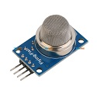
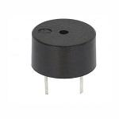
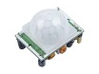
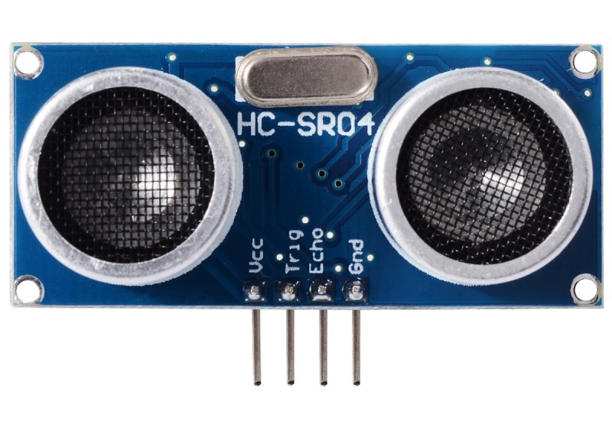
Components that make Peach Salinger’s life easy
Buzzer
Gas sensor
A buzzer is an audio signaling device.
PIR sensor
This sensor detects the presence of gases in an area and converts to corresponding electrical signal.
Ultrasonic sensor
PIR Sensor allows you to sense motion, almost always used to detect whether a human has moved in or out of the sensors range.
To measures the distance of a target object by emitting ultrasonic sound waves, and converts the reflected sound into an electrical signal.

Slide 6
Method:
Step 1
step 2
step 3
step 4
Make use of ultrasonic sensor to sense the distance between the door and person entering. Write the code in such a way that the door(servo motor) should open for 10s when the sensor detects the person within a range of 50cm.
Use PIR sensor to detect any movement in the living area, if any movement is detected make LED go HIGH for 30s. If there’s no motion detected, make LED go LOW. use If-else condition.
Make use of gas sensor to sense LPG gas leakage. If the gas leakage is sensed make exhaust fan(DC motor) run.
For an alert system use a Piezo/ Bulb.
Now its really done.

Slide 7



Joe sneaking up on Peach, just Joe being Joe.
Hey, if Y’all wondering who Peach Salinger is… here she is.
The look on their face when they both realize they were stalking the same person!!!

Slide 8
Resources:
Check out these links for reference.
https://randomnerdtutorials.com/arduino-with-pir-motion-sensor/
https://create.arduino.cc/projecthub/2013lucasrodrigues/helmet-that-help-in-social-distancing-12071e?ref=search&ref_id=ultrasonic%20and%20PIR%20sensor%20projects&offset=2
https://create.arduino.cc/projecthub/Aritro/smoke-detection-using-mq-2-gas-sensor-79c54a

Slide 9
Thank you!
- IEEE UVCE PES

